Slide 1
Does Illinois have a better energy profile than California?
Jielu He
jieluh@uchicago.edu
April 14

Slide 2
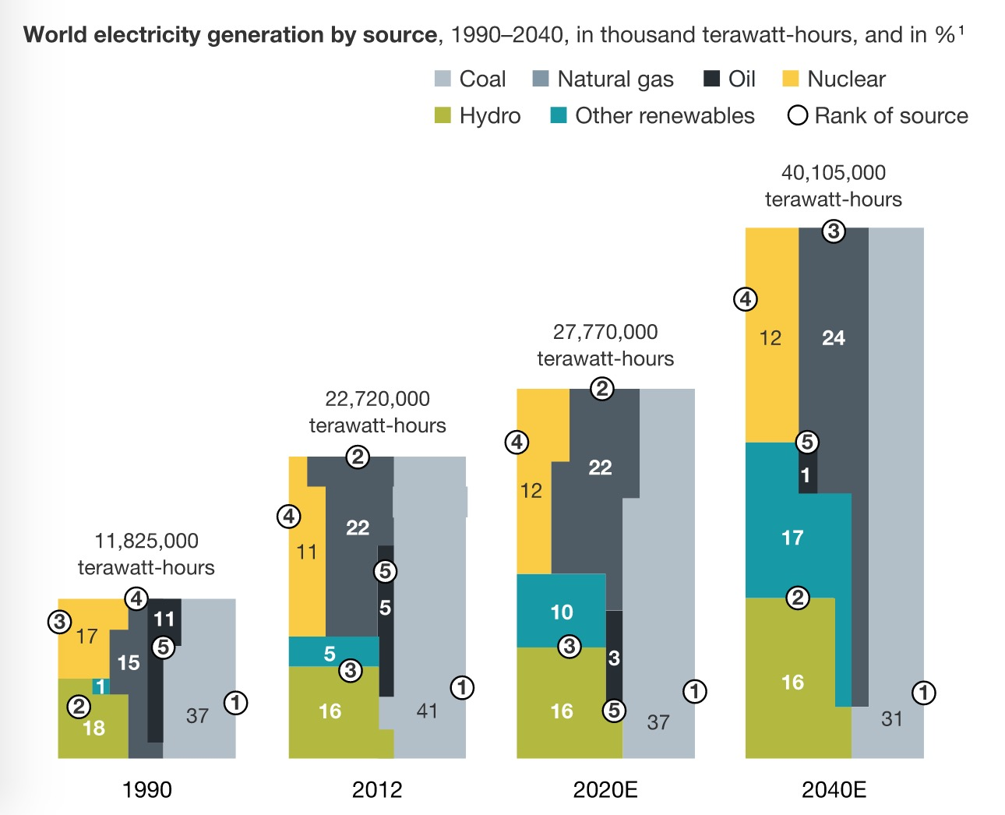
1
MOTIVATION

Slide 3
1
MOTIVATION
Energy is on a journey of important change. Inspired by the interstate cooperation between states, the renewable energy industry in the U.S. is riding some strong tailwinds that will likely promote longer-term growth.
However, according to the information compiled by Looking Ahead: The 50 Global Trends That Matter, the majority of the planet’s electricity needs will still be fueled by coal and natural gas in 2040.

Slide 4
2
RESEARCH QUESTION
Can we quantify and compare the overall energy profiles in different states?
How to achieve a better energy profile in the future?
This study builds an Energy Profile Evaluation Model in light of Energy Transition Theory and creates a rule for the target decision on renewable energy usage in the future.

Slide 5
3
LITERATURE
[1] Smil, Vaclav. 2010. Energy Transitions. History, Requirements, Prospects. Praeger
[2] Grübler, A. 1991. "Diffusion: Long-term patterns and discontinuities". Technological Forecasting and Social Change. 39 (1–2): 159–180.
[3] Grübler, A; Wilson, C.; Nemet, G. 2016. "Apples, oranges, and consistent comparisons of the temporal dynamics of energy transitions". Energy Research & Social Science. 22 (12): 18–25.
[4] Christopher F. Jones 2016 : Energy Transitions in the United States - Worker opportunities past, present, and future

Slide 6
4
DATA
Table Influential indictors
 | MSN | Description
Expenditure per capita | GDPRX | Real gross domestic product
 | TPOPP | Resident population including Armed Forces
Resources endowment | CLPRB | Coal production
 | PAPRB | Crude oil production (including lease condensate)
 | NGMPB | Natural gas marketed production
 | NUETB | Electricity produced from nuclear power
 | ROPRB | Renewable energy production, other than fuel ethanol
Geography | TEMP | Temperature
 | PPT | Precipitation
Consumer preference | CLTCD | Coal average price, all sectors.
 | CLTCB | Coal total consumption
 | NGTCD | Natural gas average price, all sectors (including supplemental gaseous fuels)
 | NGTCB | Natural gas total consumption (including supplemental gaseous fuels)
 | PATCD | All petroleum products average price, all sectors
 | PATCP | All petroleum products total consumption
 | ESTCD | Electricity average price, all sectors.

Slide 7
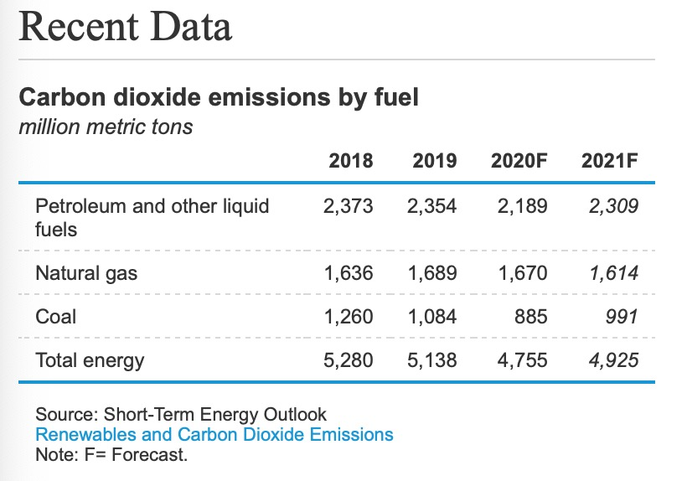
4
DATA
https://www.eia.gov

Slide 8
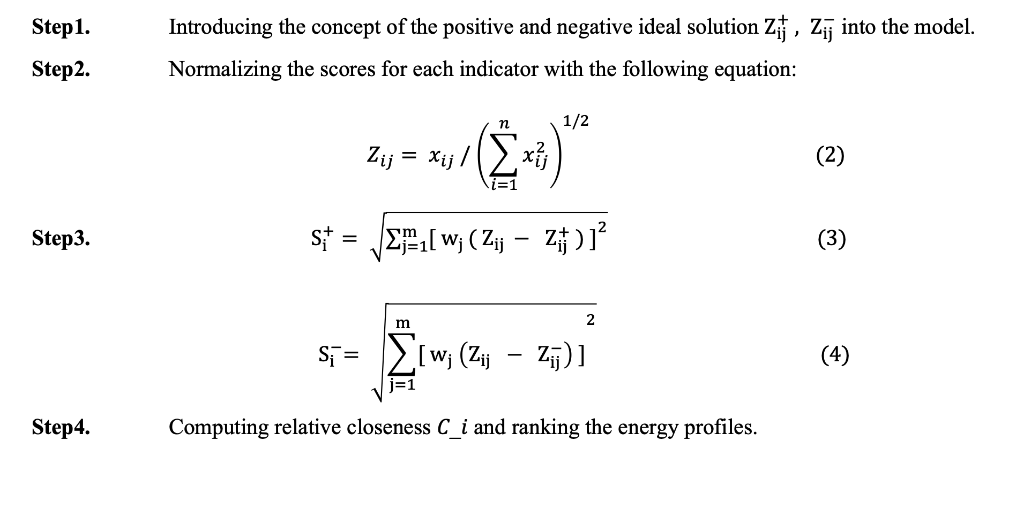
5
METHODS
Modified TOPSIS method
Step1. Introducing the concept of the positive and negative ideal solution $Z_{ij}^{+} , Z_{ij}^{−}$ into the model.
Step2. Normalizing the scores for each indicator with the following equation:
$$Z_{ij}= x_{ij} /{ \left(\sum_{i=1}^{n}{x_{ij}^{2}}\right)}^{1/2} (2)$$
Step3. $S_{i}^{+}= \sqrt{{\sum_{j=1}^{m}{[{ w}_{j }( Z_{ij }− Z_{ij}^{+} ) ]}}^{2}} (3)$
$${ S}_{i}^{−}= \sqrt{{\sum_{j=1}^{m}{[{ w}_{j} \left(Z_{ij} − Z_{ij}^{−}\right) ]}}^{2}} (4)$$
Step4. Computing relative closeness 𝐶_𝑖 and ranking the energy profiles.

Slide 9
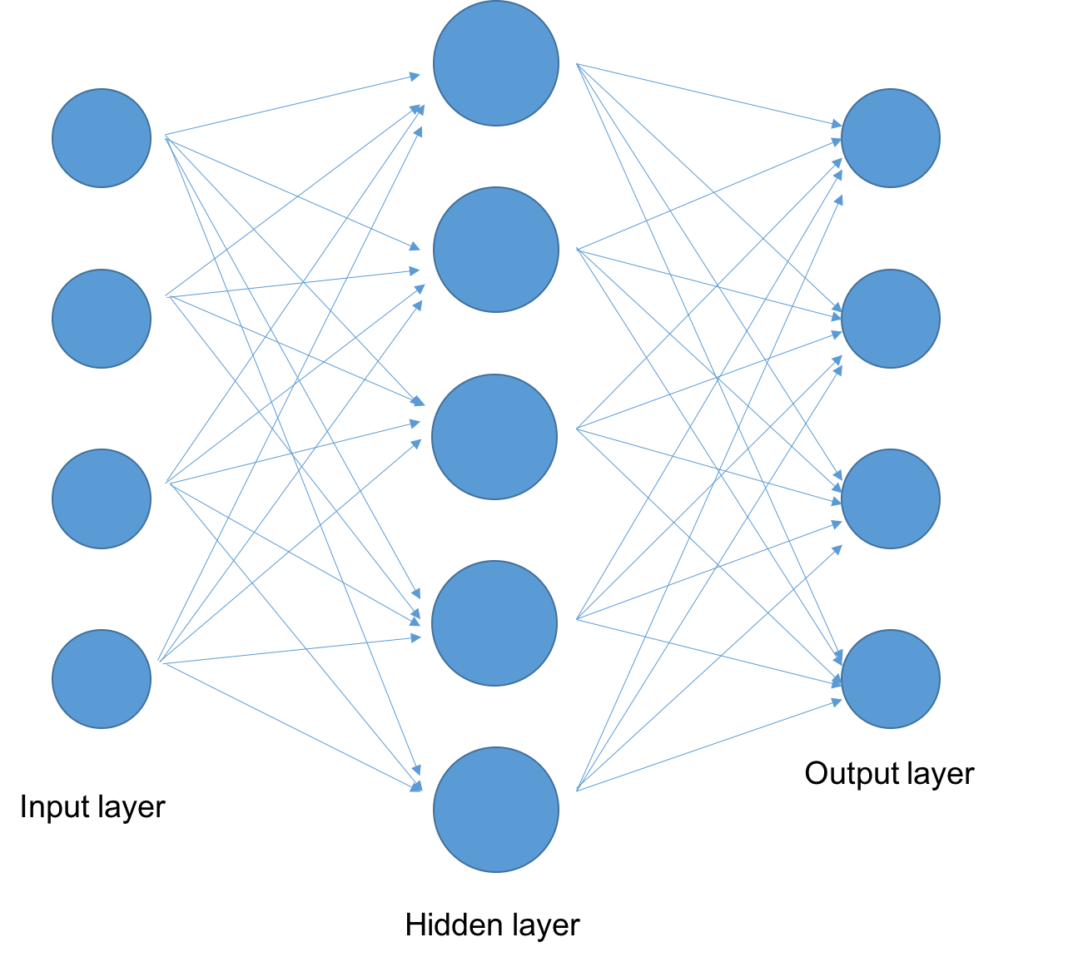
5
METHODS
Single-hidden Layer BP Neural Network
Fig The Diagram of Layers

Slide 10
6
EXPECTED RESULTS AND FUTURE STUDIES
Based on the energy transition theory, I will classify the variables to evaluate the energy profile and evolution. More specifically, I want to construct models to figure out the influential factors of renewable energy usage, estimate the energy utilization and finally predict the future optimal energy profile for different states.
My future work will focus on taking other elements like topography and history events into consideration so that I can provide more pragmatic and realistic recommendations to state governments.

